Slide 1

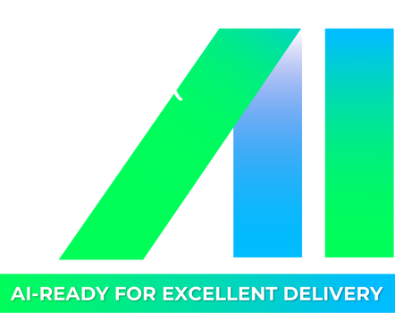


🚀 Workshop 4: Building Chatbot RAG Systems with Vector Store, Langchain & Function Calling
Date

Slide 2



🎯 Workshop Objective
🚀 Advanced Retrieval-Augmented Generation
🧠
Building intelligent chatbots that retrieve and generate knowledge
What you'll learn:
⛓️ Langchain
Prompt & Chain Management
🗃️ FAISS/PineCone
Fast Vector Search
🔧 Function Calling
Dynamic Capabilities
📝 Handle prompts effectively
3

Slide 3

💼 Application Options
Choose One or Define Your Own:
🎧 Customer Support
Intelligent FAQ bot with context-aware responses
👋 Employee Onboarding
Assistant for new hire processes and policies
🛠️ IT Helpdesk Bot
Technical support and troubleshooting
📈 Sales Lead Qualification
Product knowledge assistant for sales teams
4

Slide 4
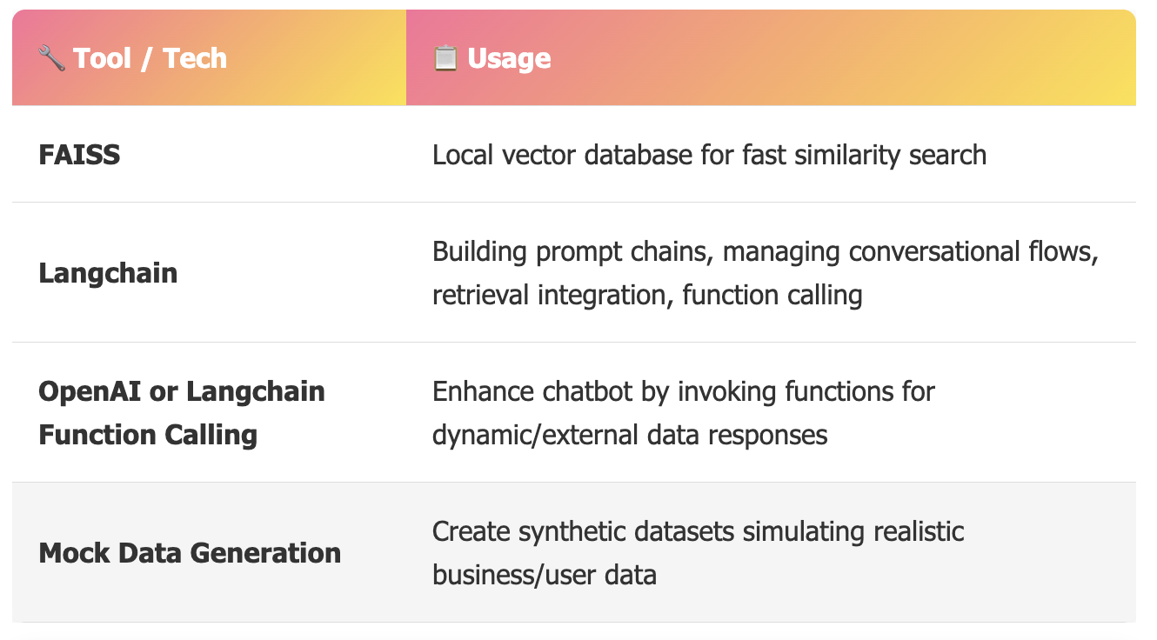
🛠️ AI Tools Usage Guidelines
👥 Team Composition & Roles (Individual Focus)
🤝 Teams of 4–5 participants collaboratively develop all aspects
🚫 No fixed roles - members share ideation, coding, prompt engineering, and testing
🎯 Focus: End-to-end RAG pipeline from data embedding → retrieval → generation + function calling
5

Slide 5

🎁 Deliverables by End of Workshop
📋 Clearly defined problem statement and mock data schema
🗃️ FAISS, PineCone or vector store populated with embeddings
⛓️ Langchain chain configuration combining retrieval and generation
🔧 Azure OpenAI function call integration extending chatbot abilities
💻 Fully functional chatbot prototype with UI or notebook
🎤 Team presentation with demo, insights, and lessons learned
6

Slide 6
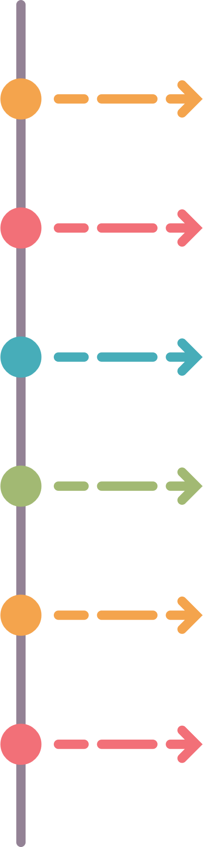
📋 Timelines
9:00 – 9:10
Stabilize seats for Trainees, take attendance
9:10 – 9:30
Share artifact files with Trainees . Describes the problem statement, deployment format, desired output.
09:30 – 12:00
Trainees: Discuss and implement Submit all to SharePoint
Trainer: Rotate multiple groups to support
12:00 – 13:00
Lunch Break
13:00 – 15:50
Presentation
15:50 – 16:00
Workshop Summary
7

Slide 7


THANK YOU!
🎉 Ready to Build Amazing AI Tools?
Let's turn your repetitive tasks into automated solutions!
8

